Slide 1

Exploration of inference serving systems on LLM performance
Jeremy Money, Paratee Komen, Vu Nguyen
CSCE 585 Machine Learning Systems
December 7, 2023
Instructor: Dr. Pooyan Jamshidi

Slide 2
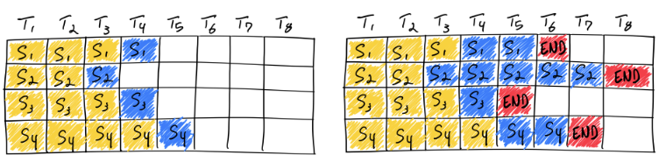
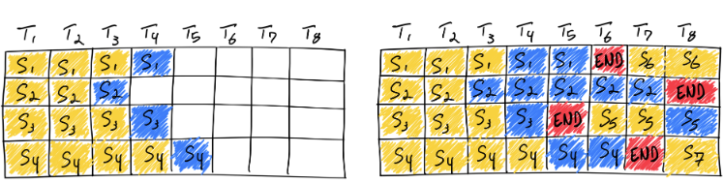
Problem Statement
Scaling LLMs dynamic to meet EULA while optimizing resources
LLMS I/O are memory bound
Memory requirements scales with model size and token sequence length
Underutilization of total memory cache scales with variance in input length
Problem is exemplified in dynamic input usage like with chatbots
Static
Continuous
Liaw, R., et al, (2023), https://www.anyscale.com/blog/continuous-batching-llm-inference
“White space represents unused memory!”

Slide 3


Problem Statement
To explore and compare the effect of HuggingFace’s text-generation-inference (HF-TGI) and vLLM inference systems on LLM performance metrics (throughput and latency)
Understand the underlying mechanisms behind performance improvements and recapture previously reported results
VS
HF-TGI
vLLM

Slide 4
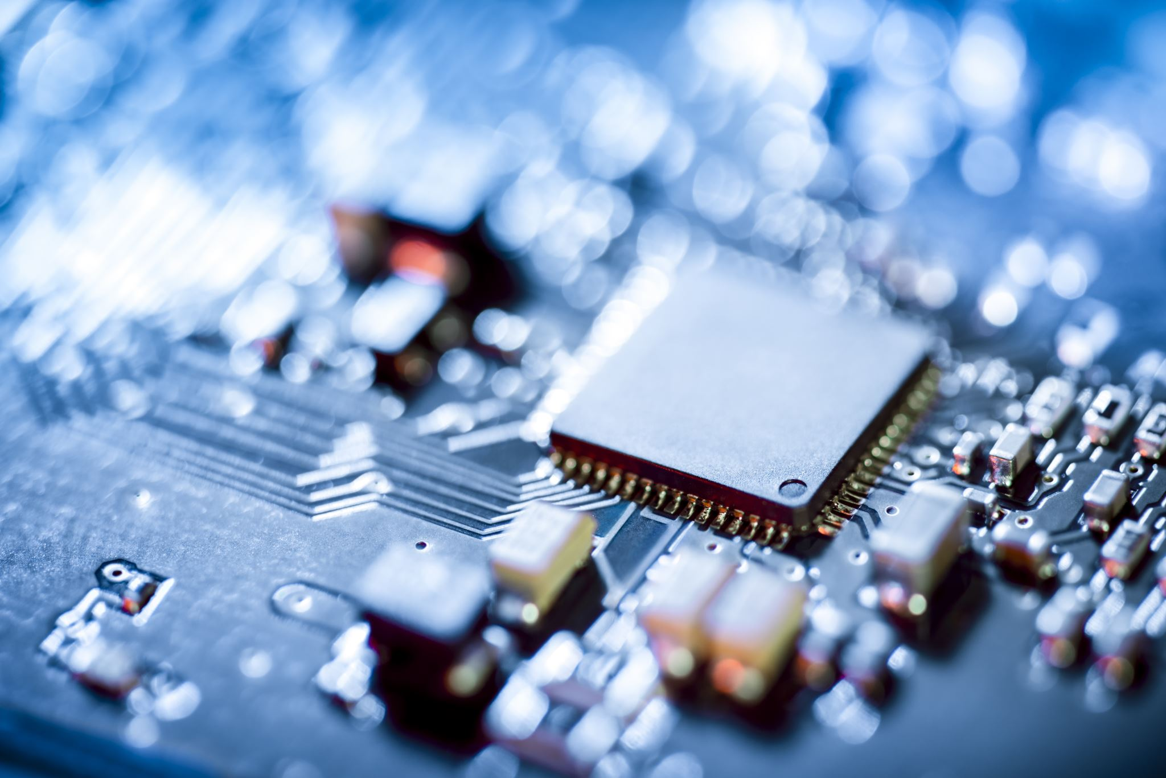



Technical Challenges
Initializing model and respective framework: Local? Colab? Cloud based service?
Subsequent challenges with learning the framework, installing dependencies, creating environments, etc.
– Selected/built instances on CHI@UC –

Slide 5
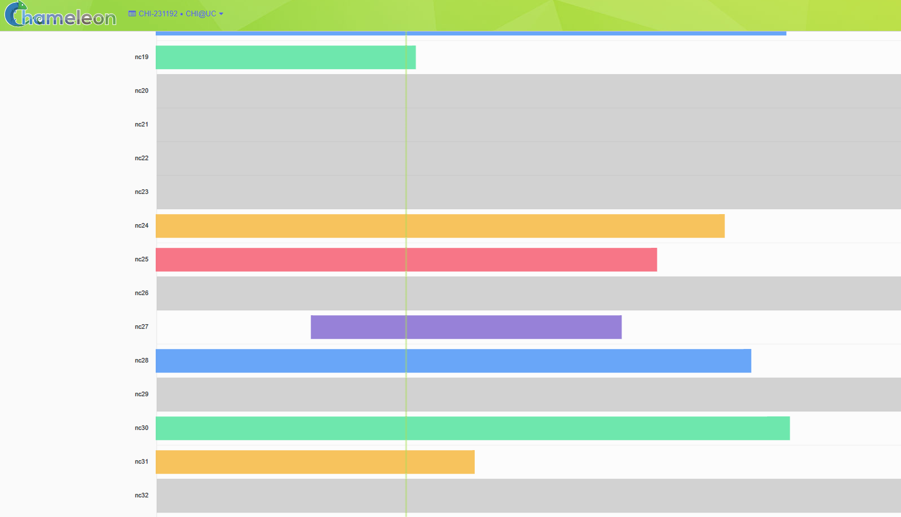
Technical Challenges
Resource allocation and leasing imposed potential time constraints (7-day allocations)
High traffic caused lease request bottlenecking
Requested RTX-6000 GPU nodes on CHI-UC

Slide 6
Methods/approach: General
Hardware: Quadro RTX-6000 Cuda enabled GPU node (24GB RAM)
OS: Ubuntu (CUDA enabled) version 22.04
Model: OPT-125M and galactica-1.3B (paper used OPT-13B)
Frameworks: HuggingFace’s text-generation-inference (HF-TGI)¹ and vLLM continuous batching²
Data analysis: Throughput and Latency
Throughput: number of requests handled in a given timeframe
Latency: the time duration taken by an individual task or operation to be completed
¹: https://github.com/huggingface/text-generation-inference
²: https://github.com/vllm-project/vllm

Slide 7
Experimental setup: Throughput
Prompt input: 1000 sequences
Input tokens length: 512 tokens
Mean Variable Response length: 128 with exponential distribution
Generation limit: 32, 128, 512, 1536, 2048
The maximum sequence length of our model: 512+32=544, 512+128=640, 512+512=1024, and 512+1536=2048
Data Creation
Generation Lengths
≅ threshold
. . .
Data Creation
512 tokens
512 tokens
512 tokens
512 tokens
1st sequence
2nd sequence
999th sequence
1000th sequence
. . .
Sampling
30 tokens
150 tokens
120 tokens
Average ≅ 128

Slide 8
Experimental setup: Latency
Request latencies: 100 requests
Mean Variable Response length: 128 with exponential distribution
Queries Per Second (QPS): 1 and 4
Token Sampling limits: 1 to 512 (uniform distribution) tokens
Generation limit: 1536 tokens
The maximum sequence length of our model: 512+1536=2048
"Queries per second" refers to the rate at which queries or requests are made to a system within a span of one second.

Slide 9


Results: Throughput
This Work
VS
Generation Limit | Changes (vllm/HF)
 | 125 M Model | 1.3 B Model
32 Tokens | 1.2X | 1.1X
128 Tokens | 2.0X | 1.4X
512 Tokens | 2.3X | 2.0X
1536 Tokens | 2.2X | 2.1X
2048 Tokens | 1.2X | 2.0X
HF-TGI
vLLM
Previous work by Liaw, R., et al, (2023)
Generation Limit | Changes (vllm/HF) 13B Model
32 Tokens | 1.1X
128 Tokens | 1.5X
512 Tokens | 1.9X
1536 Tokens | 1.9X
source code: https://github.com/anyscale/llm-continuous-batching-benchmarks/tree/master/benchmark_configs

Slide 10
Results: Latency
VS
125 M Model
HF-TGI
vLLM
1.3 B Model
Significant reduction in HF-TGI performance
when increasing QPS consistent with literature!
source code: https://github.com/anyscale/llm-continuous-batching-benchmarks/tree/master/benchmark_configs

Slide 11
Results: Cumulative Distribution Function
Cumulative Distribution Function (CDF) vs Request latency in seconds with a) QPS = 1 and b) QPS = 4.
Significant reduction in HF-TGI performance
when increasing QPS consistent with literature!
source code: https://github.com/anyscale/llm-continuous-batching-benchmarks/tree/master/benchmark_configs

Slide 12
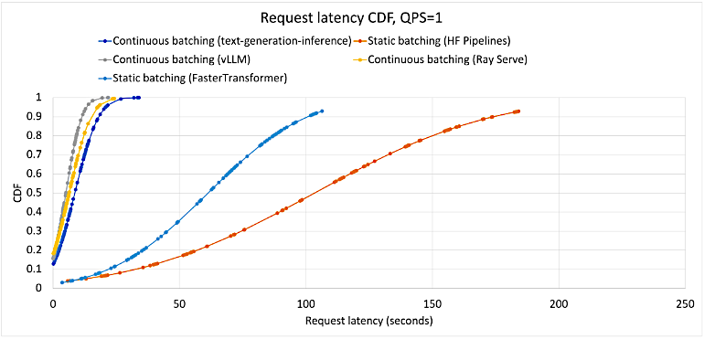
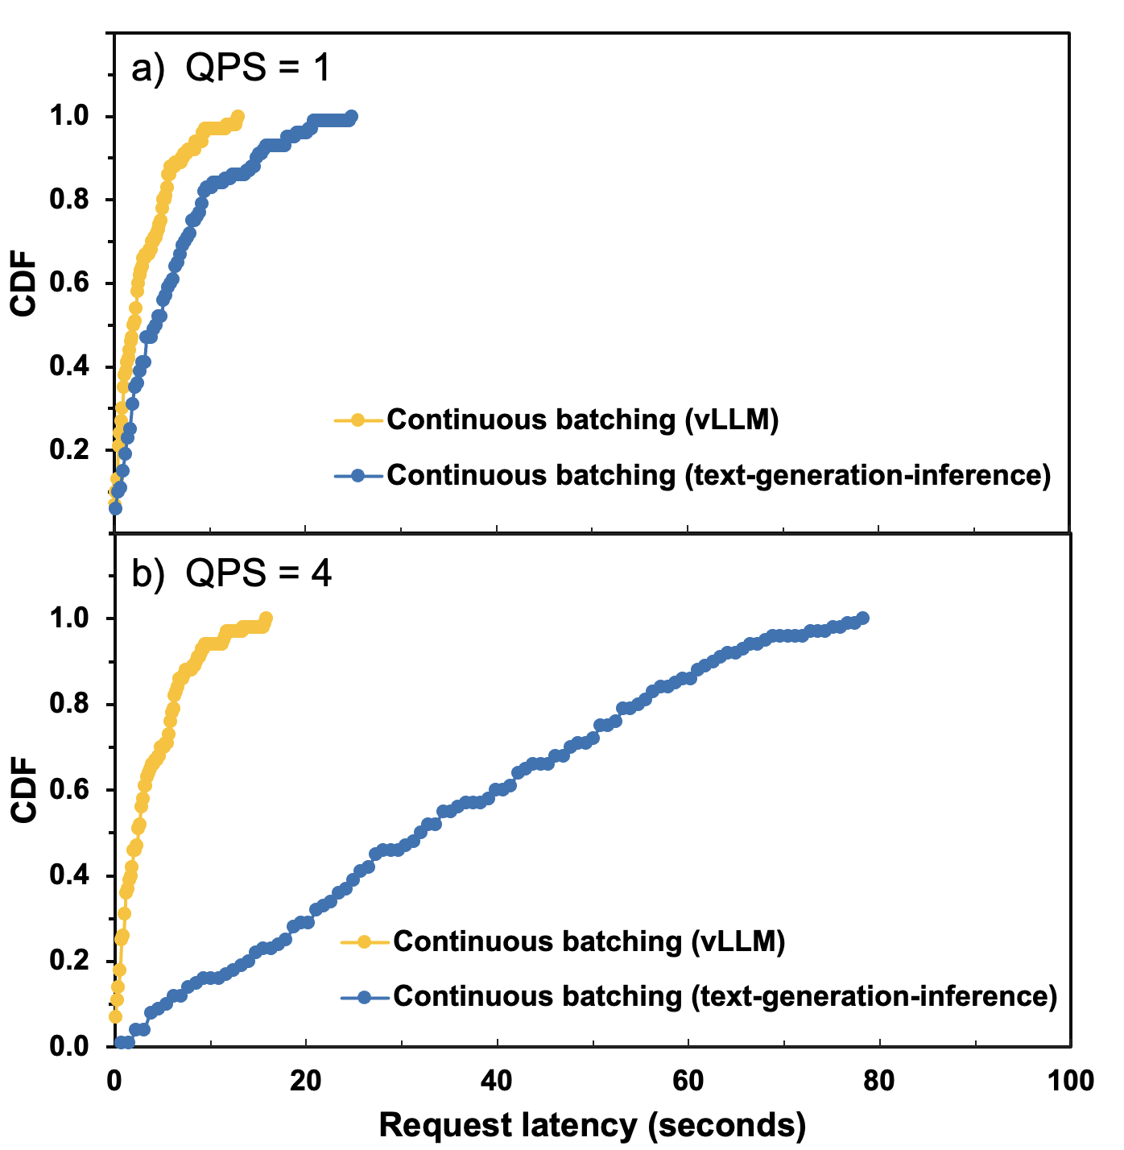
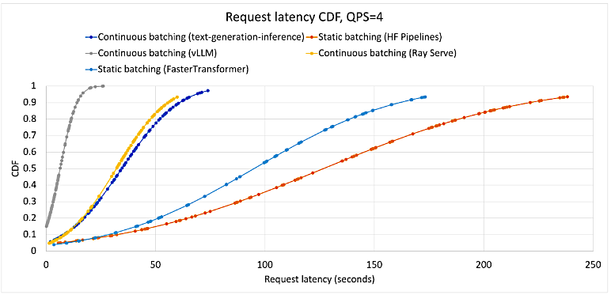



Results: Latency (cont.)
This work
Ref 1.
Trends obtained are consistent with literature!
Ref. 1: Liaw, R., et al, (2023) https://www.anyscale.com/blog/continuous-batching-llm-inference

Slide 13
Broader Impacts/Limitations/Future Directions
Inference architecture serves as a minimally invasive, proven platform for scaling LLM performance both in terms of latency and throughput
Batching algorithms sampled allow for better memory utilization of LLMs
vLLM shows marked improvement in both throughput and latency, especially with high variance in input lengths
Further studies can be explored to determine/confirm saturation limitations of architectures
Determining what max input sequence length shows no statistically significant difference between vLLM and HF-TGI
Decoupling and analyzing vLLM’s dynamic memory reservations and iterative-level scheduling can provide mechanistic insight into why its performance increase remains relatively consistent despite token length variance

Slide 14
References
1) Kwon, W., Li, Z., Zhuang, S., Sheng, Y., Zheng, L., Yu, C. H., Gonzalez, J., Zhang, H., & Stoica, I. (2023). Efficient Memory Management for Large Language Model Serving with PagedAttention. Proceedings of the 29th Symposium on Operating Systems Principles, 611–626. https://doi.org/10.1145/3600006.3613165
2) Kilburn, T., Edwards, D. B. G., Lanigan, M. J. and Sumner, F. H. (1962). One-Level Storage System, 405-517.
3) Pope, R., Douglas, S., Chowdhery, A., Devlin, J., Bradbury, J., Levskaya, A., Heek, J., Xiao, K., Agrawal, S., & Dean, J. (2022). Efficiently Scaling Transformer Inference. http://arxiv.org/abs/2211.05102
4) Dao, T., Fu, D. Y., Ermon, S., Rudra, A., & Ré, C. (2022). FlashAttention: Fast and Memory-Efficient Exact Attention with IO-Awareness. http://arxiv.org/abs/2205.14135

Slide 15
Thanks!
Name
Title
Email
Social

Slide 16
NOTES ON REQUIREMENTS
Problem Statement: Briefly describe the problem your group is tackling. Describe the overall motivation and the input/output of the problem.
Technical Challenges: Briefly describe why the problem is technically challenging.
Related Works: Briefly in what ways previous works have tackled the technical challenges.
Your Approach and Results: Describe your detailed technical approach and innovations. Describe evaluation results (dataset and metric). Emphasize important, interesting, or unexpected results and explain the expected results compared with previously reported results.
Broader Impact: How do you expect the impact of your work to be? What can others learn from it, or how can they apply it to solve their problems? What are the limitations of your work? What are areas for future improvements?

